Slide 1
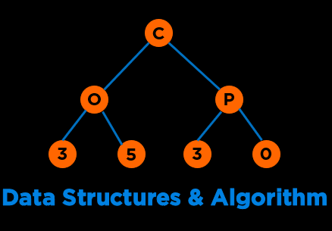
Data Structures & Algorithms
COP 3530 : Spring 2024

Slide 2












About Me: Amanpreet Kapoor
Educator
CS Education Researcher
Mentor
Software Engineer
Lifelong Learner
kapooramanpreet@ufl.edu
Notes:
My name is Aman and I will be your instructor for this course
I wear many hats and identify myself as a
Some of the organ…

Slide 3
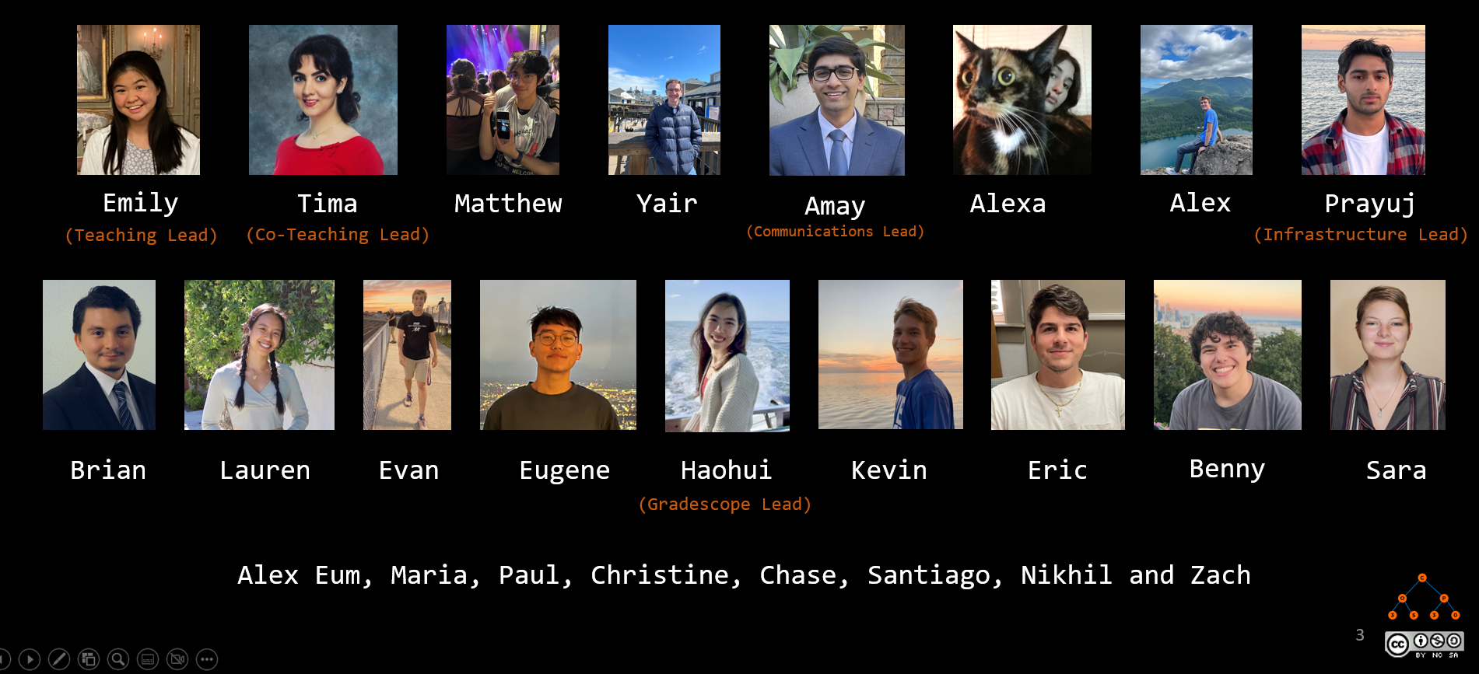
Course Staff

Slide 4
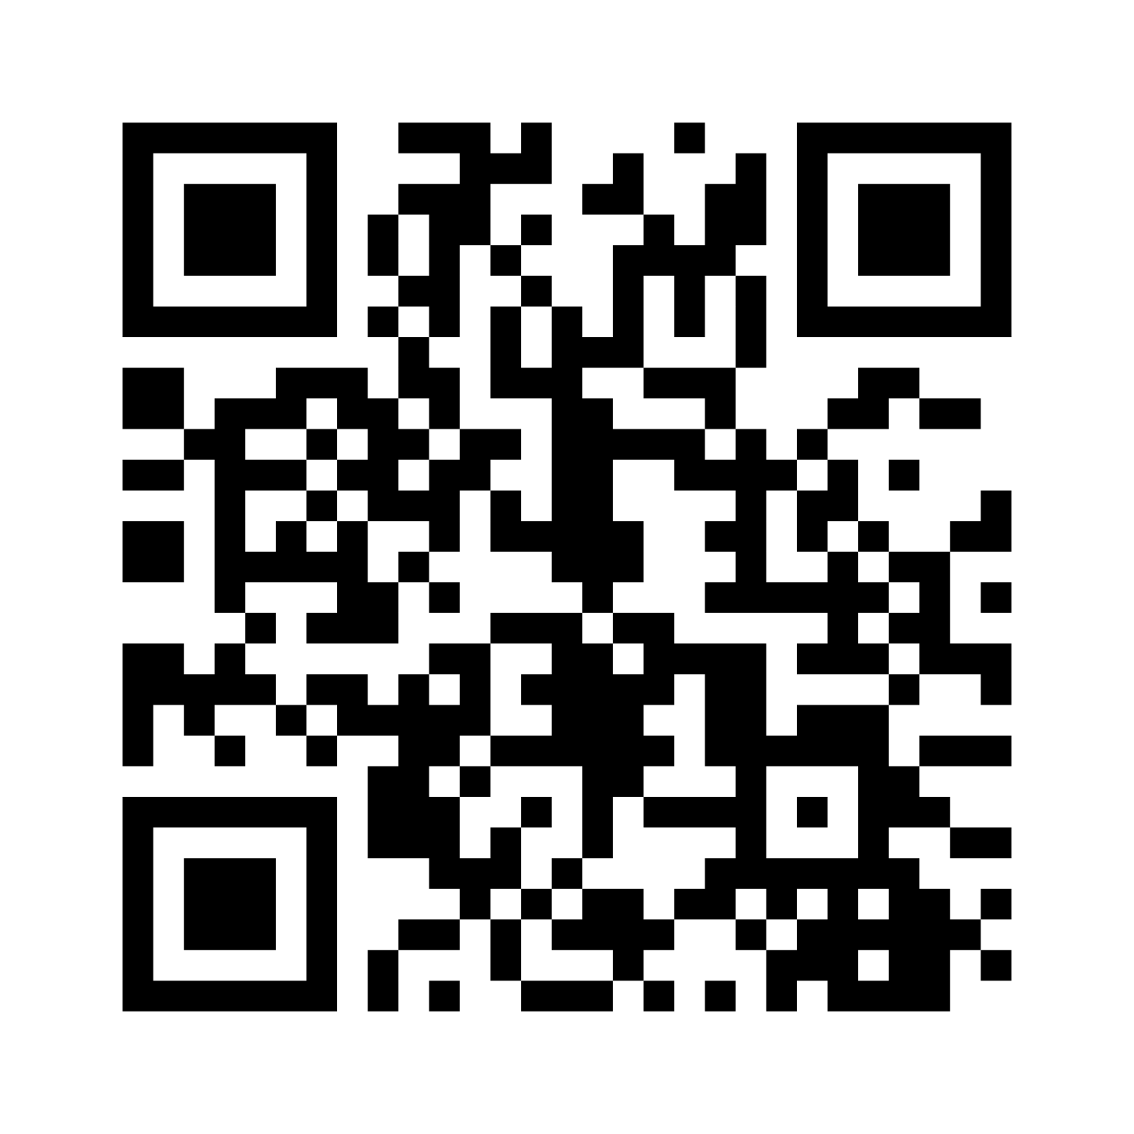
Learners: Let’s Get to Know You
Go To Menti.com
Code: 4217 4682

Slide 5
Course Objectives

Slide 6
What is this Course About?
This course covers algorithm development using
pseudo languages
basic program structures
program design techniques
storage and manipulation of basic data structures
3 Credit Hours

Slide 7
What is this Course About?
Data Structures & Algorithms
Conceptual Understanding
Critical Thinking or Problem Solving
Implementation
Notes:
Psuedocode and code

Slide 8

Categories of Data Structures
Linear Ordered
Non-linear Ordered
Not Ordered
Lists
Trees
Sets
Stacks
Graphs
Tables/Maps
Queues
Notes:
Data structures are ways to collect data. There are basic categories of data structures:

Slide 9

Categories of Algorithms
Brute Force
Divide & Conquer
Greedy
Dynamic Programming
Selection Sort
Binary Search
Minimum Spanning Tree
Knapsack
Bubble Sort
Merge Sort
Shortest Paths
Fibonacci
Insertion Sort
Quick Sort
NP Complete Problems
Notes:
We will be talking about various DS and Algo

Slide 10
Logistics & Policies
Notes:
But what do we truly care about?

Slide 11





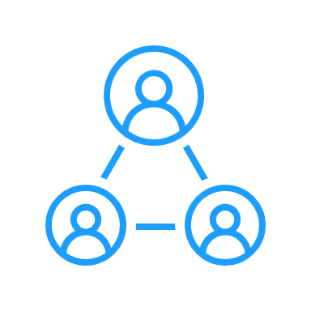

Format
Action Items by Monday morning
Watch lectures synchronously on Mon, Wed, Fri live or via Zoom.
Conceptual Quiz due on Fri.
Programming Quiz due on Fri.
Attend discussions on Tue/Wed.

Slide 12

Communication
Slack
Office Hours
Everything!
– for all question related to the course
– for communicating with peers
- one-to-one communication with me
Use Appropriate Tags
Response in < 48 business hours
Monday 4:30-6:30 pm
By Appointment (24 hours in advance)

Slide 13

Communication
Email
Email
Fine for
Personal
Accommodations
Emergencies
Not okay for
Questions regarding logistics
Questions on coding
Fixing bugs

Slide 14



Communication
Canvas Messages
Phone Call

Slide 15
Debugging
Students should visit the course staff during scheduled office hours for help and provide context for help.
Debugging requests for projects/quiz questions must first go through the TAs or peer mentors. This is strongly encouraged given we have a large class and several of you might have similar questions.
If your problem is not fixed, then start a conversation with both the Instructor and the TA/Peer mentor who you asked for help. Debugging requests to the Instructor as a Slack direct message or an email will be ignored if you do not follow the above protocol.

Slide 16
Grading
Modality | Assignment | % of Final Grade
Individual | Programming / HTG Quizzes (drop two lowest) | 12%
 | Conceptual quizzes (drop two lowest) | 10%
 | Exam 1 | 20%
 | Exam 2 (Cumulative) | 20%
 | Project 1 | 14%
 | Project 2 | 10%
 | Discussion participation activities | 4%
Collaborative | Final Project (Individual or Group: 3a & 3b) | 10%
Individual | Extra Credit Opportunities & Bug Bounty Program | Up to 3%
 |  | Total: 103%
Total assessments: 26 excluding extra credit and class participation

Slide 17
Timeline
Week | Dates |  | Topic | Deadlines
1 | 8-Jan | 14-Jan | Course Introduction/ Algorithm Analysis
2 | 15-Jan | 21-Jan | List, Stacks, & Queues | Q_{1,} Q₂
3 | 22-Jan | 28-Jan | Trees & Traversals | Q₃
4 | 29-Jan | 4-Feb | Balanced Trees 1 | Q₄
5 | 5-Feb | 11-Feb | Balanced Trees 2 | Q_{5a}
6 | 12-Feb | 18-Feb | Heaps & Priority Queues | Q_{5b}
7 | 19-Feb | 25-Feb | Sorting | P_{1,} Q₆
8 | 26-Feb | 3-Mar | Exam 1 (March 1) | E₁
9 | 4-Mar | 10-Mar | Sets, Maps, & Hashing | P_{3a}
10 | 11-Mar | 17-Mar | Spring Break
11 | 18-Mar | 24-Mar | Graphs 1 | Q₇
12 | 25-Mar | 31-Mar | Graphs 2 | Q₈
13 | 1-Apr | 7-Apr | Greedy Algorithms | P_{2,} Q₉
14 | 8-Apr | 14-Apr | Exam 2 (April 12) | E₂
15 | 15-Apr | 21-Apr | Dynamic Programming | Q₁₀
16 | 22-Apr | 24-Apr | Complexity Theory | P_{3b}
Legend: Q_{N} = Quiz N, P_{N} = Project N, E_{N} = Exam N Note: The instructor will be traveling for official work on Mar 20 and Mar 22 and these two lectures will be prerecorded.

Slide 18
Programming Language
Default (Project 1 & 2, Stepik/Edugator, Quizzes):
C++14
Project 3 or Final Project:
Any Language
Compilation command:
g++ -std=c++14 -Werror -Wuninitialized -o EXECUTABLE_NAME YOUR_FILE.cpp

Slide 19



Tools
Compiler
G++
Stepik/Edugator/Gradescope
IDE
OnlineGDB
Visual Studio Code
Clion
Notes:
Why Stepik: you wont have access top an ide and previously students said that it helps; iT wont get you a job but it will help you develop confidence

Slide 20
Tools
Directory Structures
src – includes .h and .cpp files
(You can use lib/ too for separating interfaces - .h)
test – contains test files
build – contains executables (e.g. .exe)
Know basic commands on compilation through command line:
cd, ls, mv, g++, pwd …
https://cplusplus.com/forum/beginner/261697
https://stackoverflow.com/questions/2360734/whats-a-good-directory-structure-for-larger-c-projects-using-makefile
Notes:
Why Stepik: you wont have access top an ide and previously students said that it helps; iT wont get you a job but it will help you develop confidence

Slide 21
Textbook (Optional)
Data Structures and Algorithm Analysis in C++
Mark Allen Weiss
Fourth edition, 2014, ISBN 9780132847377
OpenDSA Book
https://opendsa-server.cs.vt.edu/OpenDSA/Books/Everything/html/index.html

Slide 22
Feedback
COP 3530 Feedback Form
Bug Bounty Program
Quiz is not accessible due to a locked module
Typo in one of the quizzes/project descriptions
Incorrect solution in a certain test case
An accessibility bug such as no headings in documents for screen-readers
the algorithm has an off-by-one error

Slide 23
Expectations
We want you to focus on
Correctness
Clean, readable, tested, and documented code
Secondary focus on optimization
The course will not cover
Mathematical Proofs
Design Patterns
Competitive Programming

Slide 24
Expectations
Conceptual Quizzes and Exams:
Work independently
No discussion at the conceptual level
You are allowed to
discuss solutions after the due date and late days have passed.

Slide 25
Expectations
Programming Quiz questions:
Work independently or as a pair (Select a buddy in Week 1).
The buddy must remain the same for the entire course.
The course staff can help you on syntax issues, but we will not help you with semantic and logic issues for quizzes.
Cite that you worked with a buddy in Line 1 of your code and add their name.
You are allowed to
discuss solutions after the due date and late days have passed.
search for C++ syntax or refer to definitions of standard functions in the C++ library. For example, using the documentation listed here is fine: https://www.cplusplus.com/reference/ or https://en.cppreference.com/w/

Slide 26
Academic Dishonesty
Project 1 and 2:
Work independently
Discussion at the conceptual level is fine if you are stuck with no sharing/viewing of code
You are allowed to
discuss conceptually without discussing any code with a peer provided you cite the peer with who you discussed it. Such discussions should be held on a whiteboard using explanation figures/pseudo-codes or through talking.
discuss solutions after the due date and late days have passed.
search for C++ syntax or refer to definitions of standard functions in the C++ library. For example, using the documentation listed here is fine: https://www.cplusplus.com/reference/ or https://en.cppreference.com/w/

Slide 27
Academic Dishonesty
Project 3 and Stepik ungraded questions:
It is fine to collaborate with peers. You must make sure you are not blindly copy-pasting another student’s code. Also, you must cite the peer you worked with at the code level or conceptually.

Slide 28
Academic Dishonesty
Sharing/copying, “borrowing” of code structure, looking at code from another student or providing such code, and plagiarism, in addition to other dishonest behaviors, are all considered to be academic dishonesty.
No information regarding the project 1 and 2, quiz, and exam solutions may be shared by students. We strongly encourage that if you have doubts, visit the course staff in-office hours. Looking at any piece of your peer’s code, sharing files, searching for solutions found online, or using someone else to code your solution is strictly prohibited.
Penalty
zero on that assignment and a two-letter final grade decrement for a first offense
E grade for second offence
For both offenses, you will be reported to the Honor Court

Slide 29
Request for Extensions
Any request for assessment extensions should be backed by official documentation (e.g., from a medical professional, etc.) and should be sent over email. Requests without documentation will be ignored. The following reasons deem ineligibility for extensions or regrades:
Failure to submit on Canvas by due date/late date. Example: If a quiz is due at 11:59 pm, and you send the file at 12:01 am, the file will not be graded. Note that most assessments are open for 4 or more days and you must start early and submit it on time. In case you miss an assignment, treat it as a learning activity and avoid that in the future.
Forgetting to turn in an assessment on time.
File naming issues or feedback issues on projects or programming quizzes. Gradescope gives you feedback and please read it and fix your file and resubmit. Note that you have unlimited attempts on Gradescope for everything and we will not grade your files if you do not adhere to instructions on file submissions and/or if the Gradescope scores your file to 0. It is your responsibility to read the feedback and fix your code. In case you miss reading the feedback, treat it as a learning activity and avoid that in the future.

Slide 30
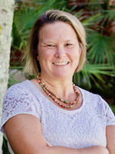
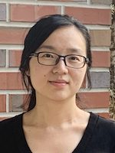
Acknowledgements
Cheryl Resch
Lecturer,
Dept. of Engineering Education,
University of Florida
Lisha Zhou
Lecturer,
Dept. of Engineering Education,
University of Florida

Slide 31
References
Books/Notes
Dr. Sartaj Sahni
Dr. James Aspen
Dr. Mark Weiss
Dr. Clifford Shaffer
OpenDSA
Dr. Cathy Hughes
Videos Authority
Dr. Josh Hug
MIT OCW 6.006: Dr. Erik Demaine and Dr. Srini Devadas
Dr. Robert Sedgewick
Videos Youtube
HackerRank: Data Structures
HackerRank: Algorithms
Back To Back SWE
MyCodeSchool
Abdul Bari
GeeksforGeeks

Slide 32
Walkthrough

Slide 33
Walkthrough
Canvas
OpenDSA
Slack
Stepik/Edugator
Gradescope

Slide 34
Questions

